Slide 1


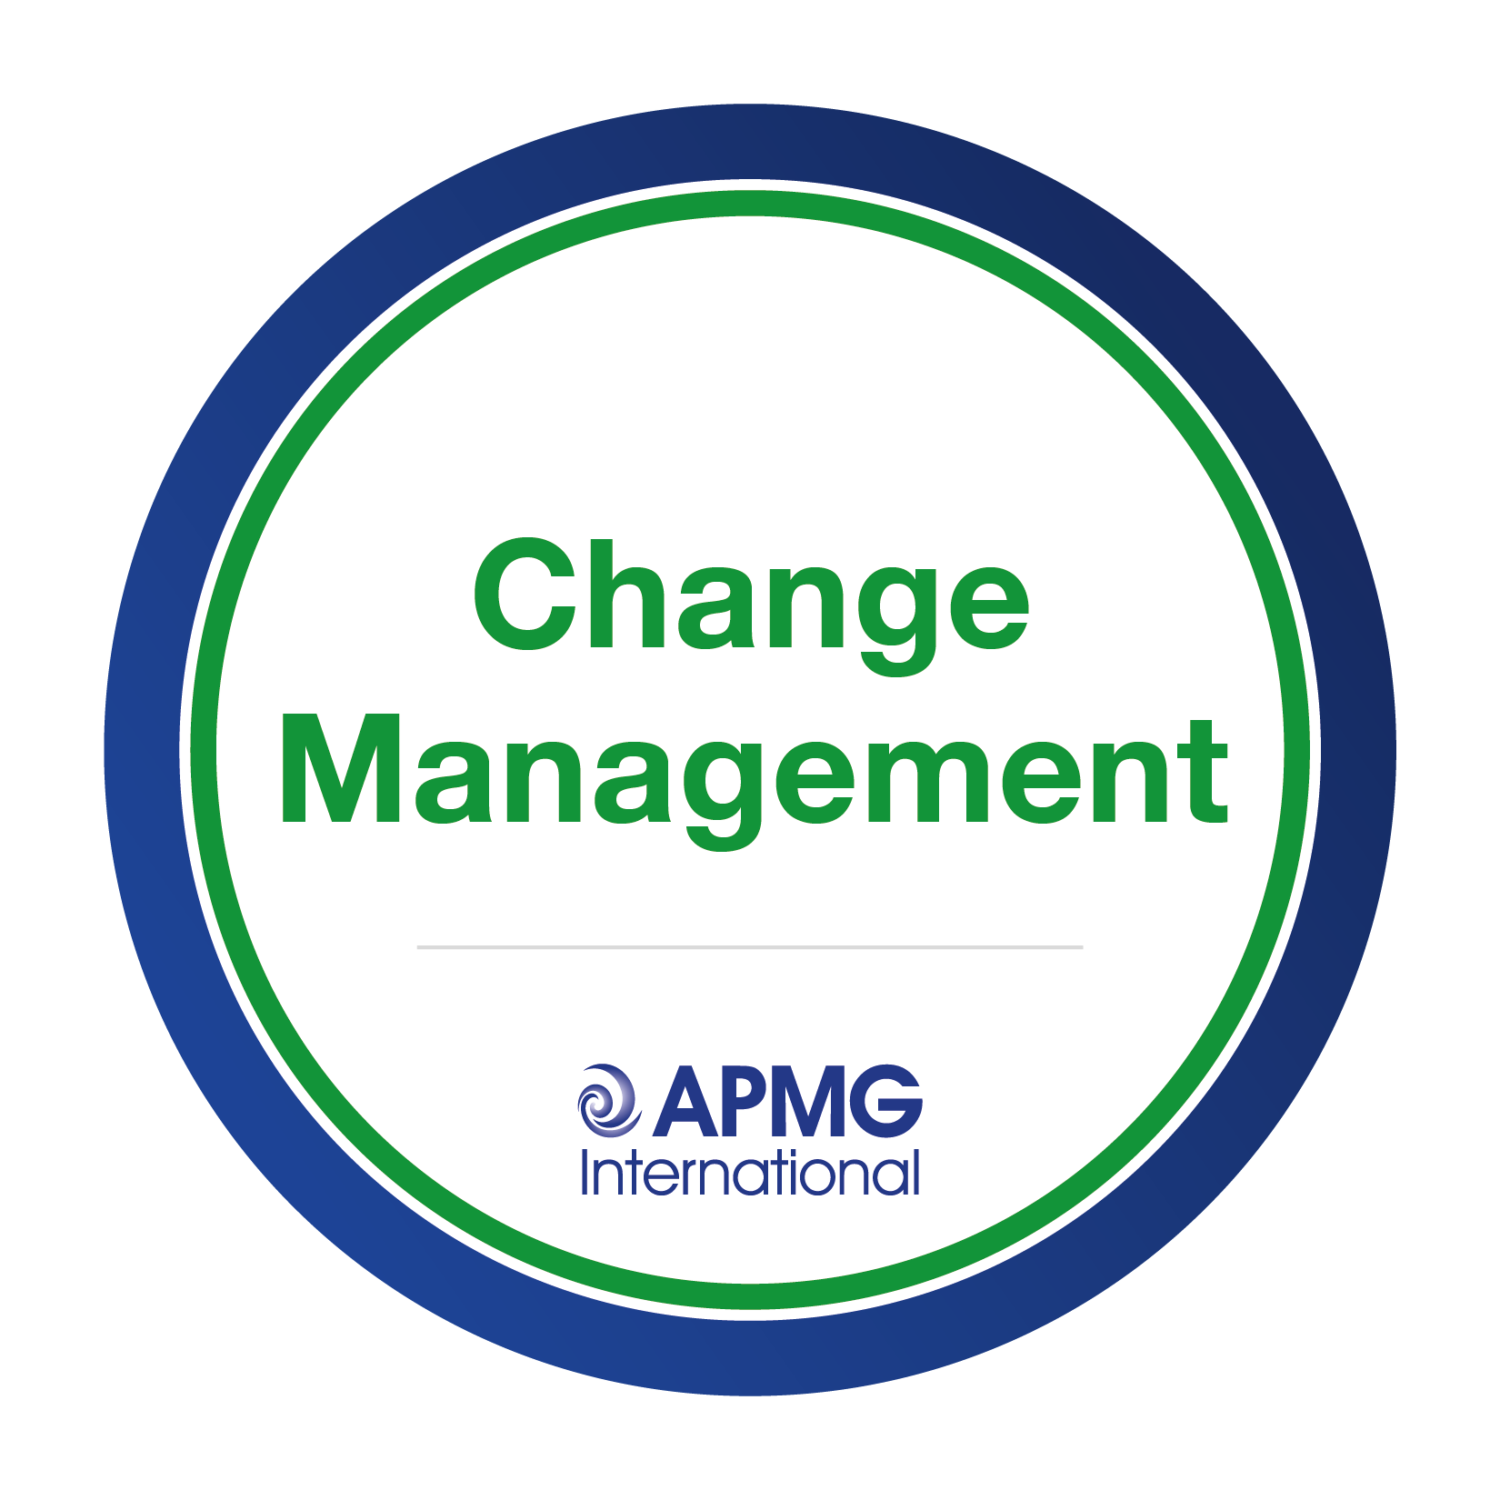

APMG CHANGE MANAGEMENT TRAINING & CERTIFICATION
apmg-international.com
CHANGE, RISK & BENEFIT

Slide 2
APMG Change Management
The definitive certification for professionals in organizational change, transition and transformation roles.
Helping organizations and their people plan, implement, and effectively manage change.
Approved training courses available globally via APMG’s network of accredited training organizations (ATOs).
Foundation and Practitioner level certification available.
Certification process accredited by UKAS
(United Kingdom Accreditation Service).
Notes:
We develop ideas:
Working with Intellectual Property Owners
Create Re-useable Content, Books, Exams, Curricula and Training Materials
We manage schemes:
Search for, select and accredit trainers, consultants, training and consulting organisations
Professionally manage and maintain content, translations and updates
We assess people and organisations:
Candidates, Trainers, Assessors and Consultants
Training and consulting, process assessments via maturity models
Surveillance and audits:
Surveillance of practitioners, trainers, consultants and companies

Slide 3

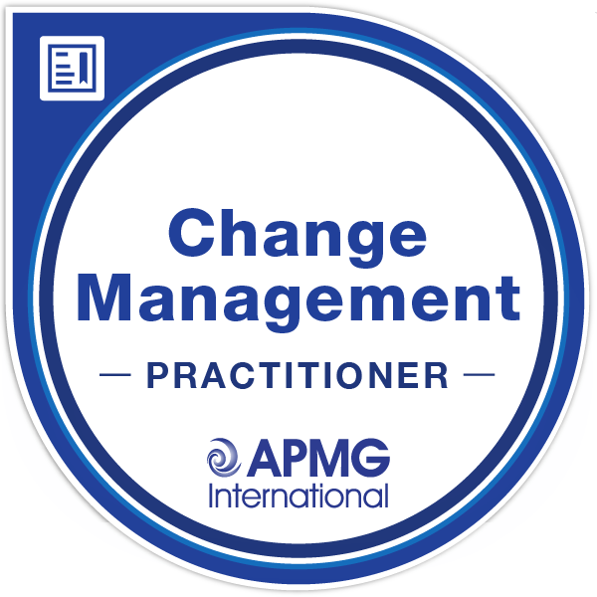

Training features
Change Management
Study Guide
Exclusively available to
learners
Covers knowledge contained in the Change Management Institute’s CMBoK
Approved Training
via Accredited Training
Organizations (ATOs)
Accredited by APMG to
offer approved training services
Certification
Foundation + Practitioner
Syllabus & exams
developed by APMG

Slide 4

Change Management Institute
Developed in partnership with the Change Management Institute—a global, independent, not-for-profit association dedicated to driving change, advocating for the change management profession, and serving as its collective voice.

Slide 5
What is Change Management?
The discipline that guides how we prepare, equip and support individuals to successfully adopt change.
Provides a structured approach for supporting individuals and teams to move from a current to future state.
The rise of Enterprise Change Management, coupled with the near-constant state of change in many organizations, has further increased the demand for qualified and experienced change practitioners, managers, and leaders.
It’s vital that those involved in implementing change are therefore able to develop their capabilities.

Slide 6
Why Change Management?
Change is inevitable. For many organizations, change is now near- continuous. The current business climate demands businesses to evolve, remain relevant and competitive, or even survive.
Dealing with change and, more importantly, the impact of change is therefore a high priority for all organizations.
Today’s IT and digital climate is a major driver for change; organizations can quickly get left behind if they fail to embrace new technology, developments and ways of working.
While all changes and individuals are unique, there are actions we can take to guide and influence others before, during and after change.

Slide 7
Vital alongside Project Management
Projects introduce change (new systems, new products, new ways of working).
Such projects typically require changes; changes to processes, job roles, organizational structures and types and uses of technology.
Change Management is the process by which we ensure these new systems / products /ways of working are adopted, and stakeholders appropriately engaged, supported and informed.
If people are unsuccessful in the personal transitions, and they don’t embrace and learn a new way of working, an initiative is likely to fail.
Project failure rates remain alarmingly high; a major reason is the failure to effectively engage with and support those affected by change (customers, partners, employees).

Slide 8
Why change can fail….
The initiative is not aligned to business objectives
Resistance from various stakeholders
Lack of engagement, information and support
Insufficient skills and personnel to effectively plan and implement change.

Slide 9
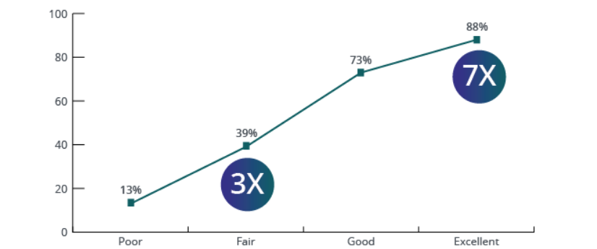
Correlation of Change Management Effectiveness with Meeting Objectives
Percent of respondents that met or exceeded objectives
2023 Prosci, Inc.
Source: Research Hub

Slide 10
Why choose APMG’s Change Management Certification?
While other popular courses focus exclusively on one approach to structuring change management, APMG’s Change Management courses enable learners to apply any change methodology effectively. The courses are agnostic about the methodology used, focusing on helping learners build a firm foundation of change management knowledge, principles, and practice.
Change Management Practitioner certification is accredited and recognised by the United Kingdom Accreditation Service (UKAS).
All trainers, materials, and organisational processes have been thoroughly assessed by APMG to ensure quality training.
These qualifications offer a pathway to accreditation by the Change Management Institute.

Slide 11
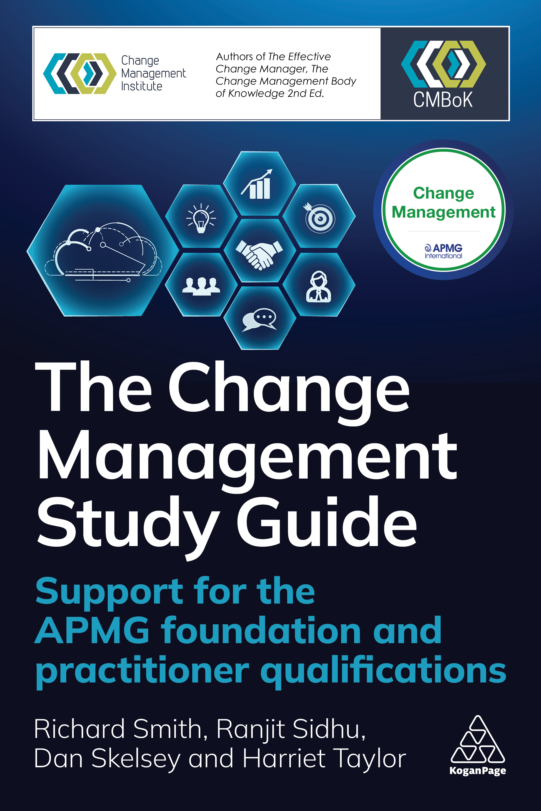
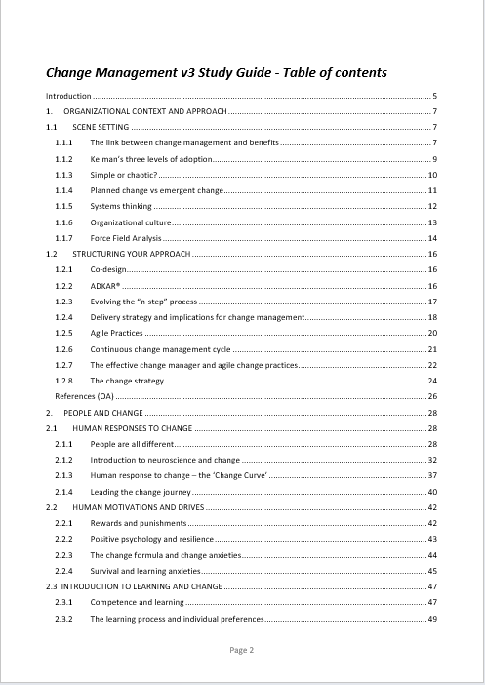
The Change Management Study Guide
Core guidance and supporting text for the
APMG Change Management syllabus and
examinations.
Covers selected knowledge contained
in the Change Management Institute’s, Change
Management Body of Knowledge (CMBoK).
5 chapters teach, the 5 areas of knowledge
defined by the CMBoK.
Provides a robust foundation of knowledge for
anyone involved in organizational change
initiatives.

Slide 12
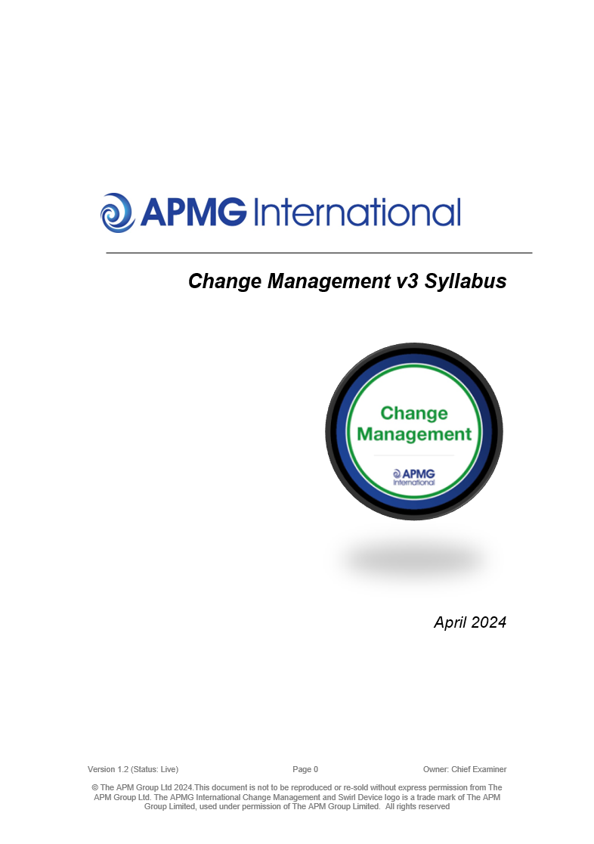
Chapters
The Change Management Study Guide: Chapters | Change Management Syllabus
Organisational Context and Approach | Organisational Context and Approach
People and Change | People and Change
Change Leadership and Teams | Change Leadership and Teams
Stakeholder Engagement and Communication | Stakeholder Engagement and Communication
The Work of the Change Manager | The Work of the Change Manager

Slide 13
Accredited Training
Available via APMG Accredited Training Organizations (ATOs)
ATOs offer a range of course options
  Public / in-house
  Tutor-lead, blended or fully online
  Foundation-only or Foundation + Practitioner
APMG accredited:
  Processes
  Courseware
  And trainers.

Slide 14

Target Audience
Change Leaders
(e.g. Senior Responsible Owners)
Change Support
(e.g. Programme Office)
Change ‘Agents’
(e.g. Business Change Managers)
Change Implementers
(e.g. Programme Managers)
Operational Line Managers / Staff
would also benefit from a higher
level of understanding

Slide 15
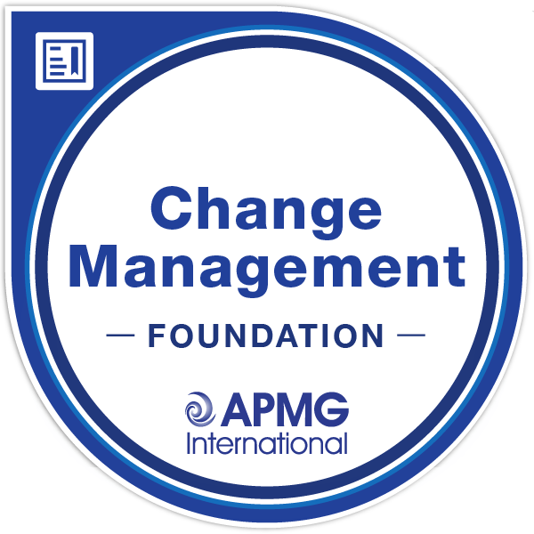
Exams
Foundation | Practitioner
Multiple-choice format | Objective-testing / case study scenario
50 questions | 4 questions (20 marks each)
50% pass mark (25/50) | 50% pass mark (40/80)
40 minutes | 2.5 hours
Closed-book | Open-book (Study Guide permitted)
No pre-requisites | Foundation pass pre-requisite

Slide 16
Benefits
Successful candidates will have the knowledge and understanding necessary to contribute constructively to teams specifying, developing, implementing and sustaining change initiatives.
Courses explore how change affects, and is affected by, individuals, teams and organizations, helping those responsible for change initiatives to:
Unlock resistance to change
Provide effective support and motivation to individuals and teams to embrace change
Draw from a range of professional approaches to implement change smoothly and effectively
Manage and inform key stakeholders throughout the change process
Speed up the implementation of change initiatives
Realize the benefits of projects, programmes and other change initiatives.

Slide 17
Learning outcomes – Foundation
Structured approaches you can use to shape a change initiative.
How to 'read' the organizational context for change.
Human responses to change and techniques to help people adapt.
Sources of resistance to change and ways to work effectively with these.
Factors affecting people's motivation during changes and how to encourage support for change initiatives.
How teams can facilitate successful organizational change and how line leaders, sponsors, change managers and change agents can best work together.
How to identify stakeholders and engage effectively with them.
Essential communication principles to support change initiatives.
Ways to assess change impacts across the organization.
How to select and effectively utilize key metrics for evaluating change.

Slide 18
Learning outcomes - Practitioner
Levers to help embed change and ensure its sustainability.
Strategies to manage learning and development in support of change.
A framework for coaching colleagues, including listening and feedback techniques.
Core insights into handling conflict during periods of change.
Approaches to facilitate collaborative design of change.

Slide 19

Digital badges

Slide 20

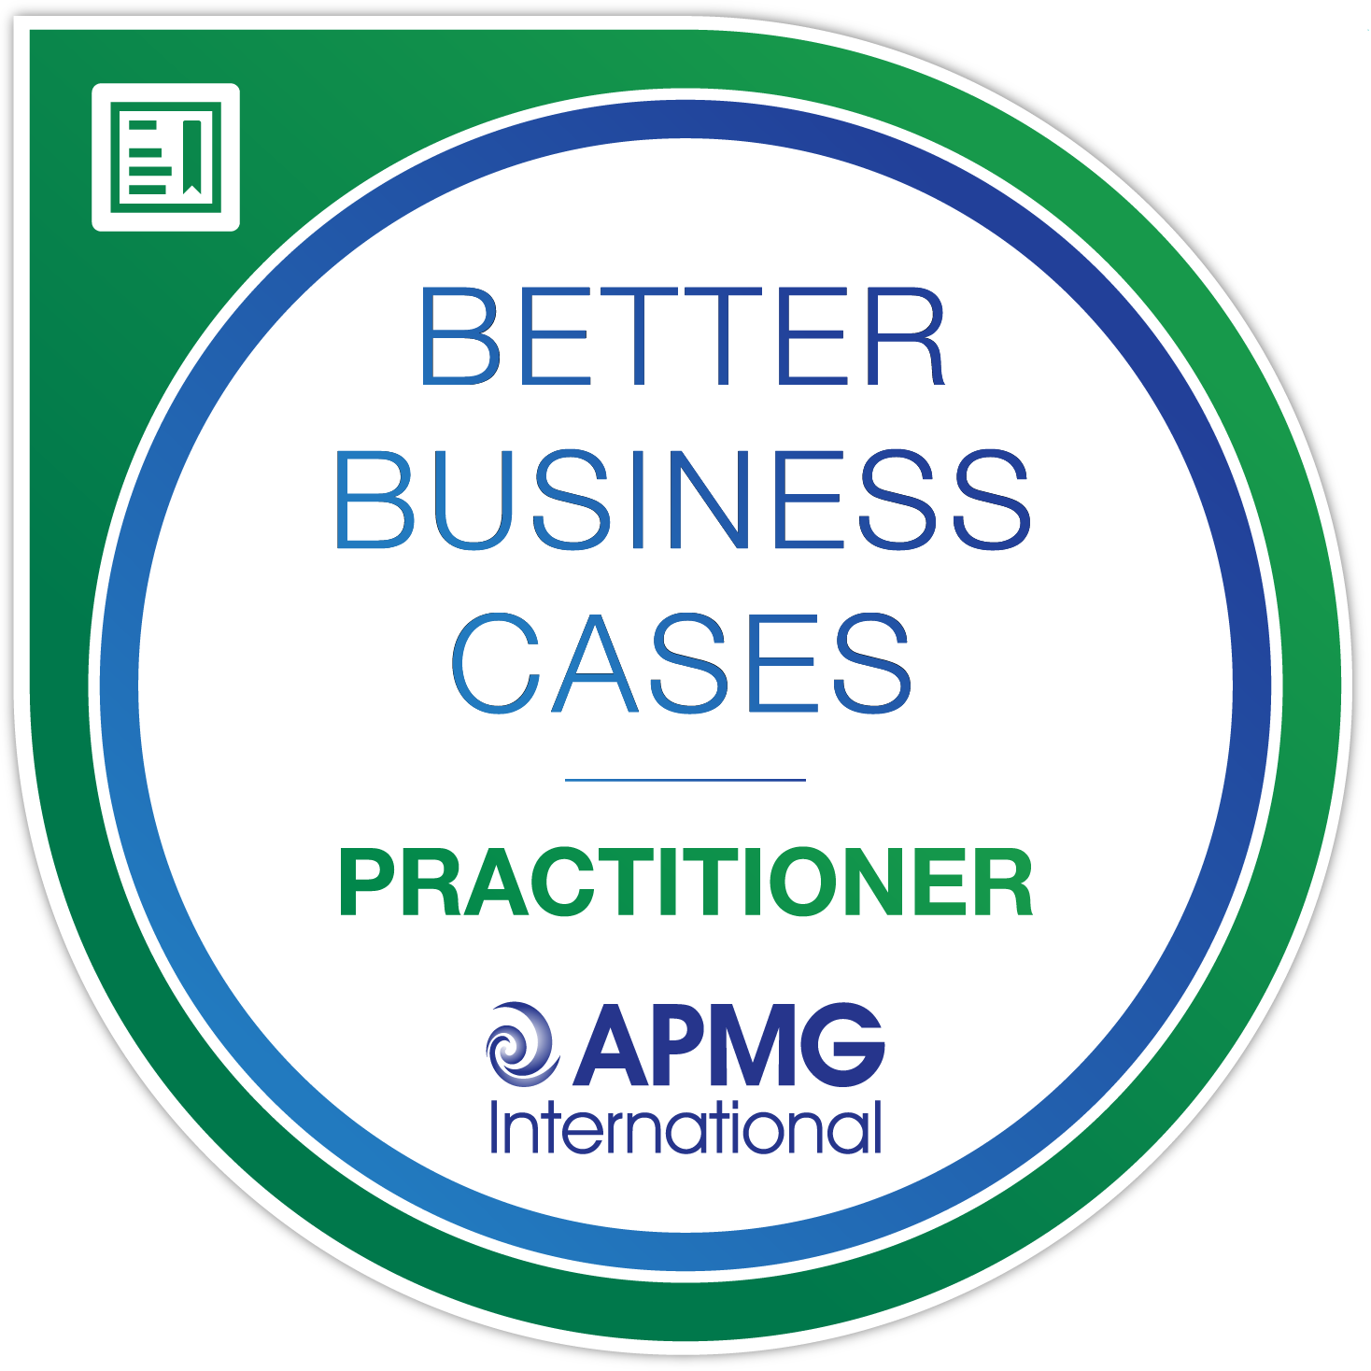
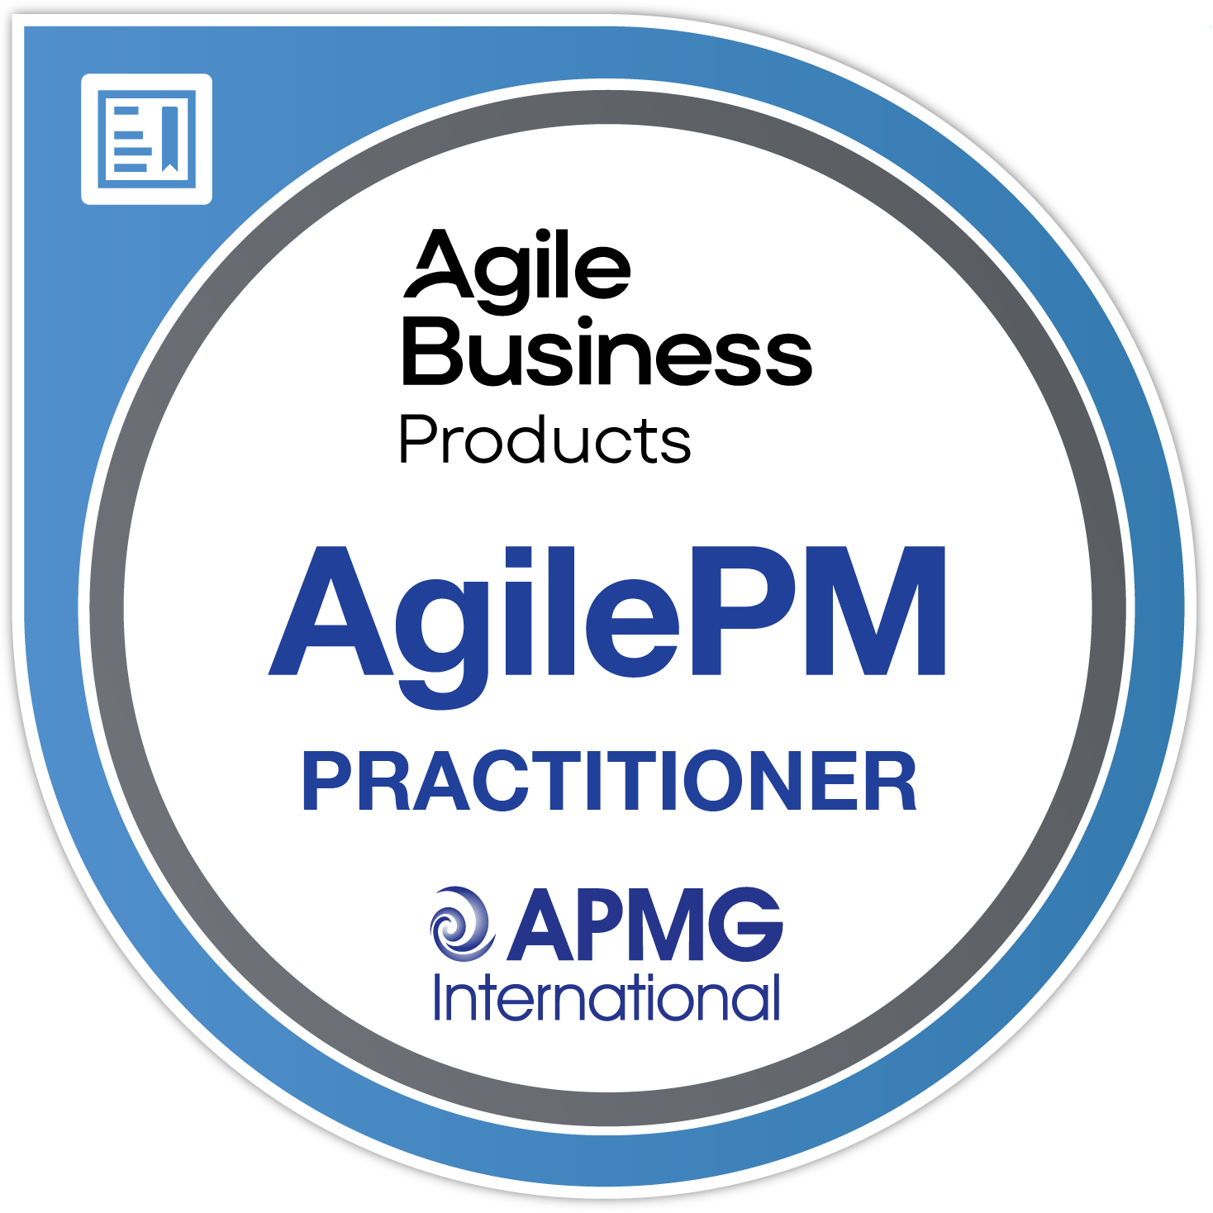

SHOWCASE YOUR ACHIEVEMENT
SHARE YOUR CERTIFIED STATUS WITH AN APMG DIGITAL BADGE
1
CREATE YOUR BADGE IN
THE APMG CANDIDATE
PORTAL
3
3
apmg-international.com/ShareYourSuccess
Claim your APMG Digital Badge in
2
EASY
EASY
ACCEPT YOUR BADGE
IN CREDLY
#ShareYourSuccess
STEPS
#ShareYourSuccess
3
STEPS
SHARE YOUR SUCCESS

Slide 21
For more information
Find out more at:
www.change-management-institute.com
Including:
Membership
Accreditation
Events
Local Chapters

Slide 22
Keeping in touch
© APMG International Ltd. 2024. All rights reserved.

